Slide 1
We’ll Go Through
2-11
React - A Walkthrough.
What is React? A basic introduction of React’s “Component” based world.
SLIDES
12-26
Getting at the core - Virtual DOM!
What is Virtual DOM? How it Works? React Virtual DOM vs. the real DOM.
SLIDES
Notes:
-> react and its core concepts.
-> Not how to install react or how to code react.
-> more important and mostly skipped part, the core of react, the virtual DOM.
-> How it functions.
-> how react virtual DOM is faster and how the real Dom is slow.

Slide 2

React JS
The Core Concepts

Slide 3
The Team Behind

Developed and Maintained by Facebook, Instagram and a community of individual developers and corporations.
React.js is
“A JavaScript library for building user interfaces”.
Its used by leading brands namely Facebook, Instagram, Whatsapp, Airbnb, Uber, Netflix, Twitter, Pinterest, Reddit, Udemy, Wix, Paypal, Imgur, Feedly, Stripe, Tumblr, Walmart and others.
Let’s
check out React’s
Terminology

Slide 4
JSX (JavaScript XML)
Allows us to write HTML like syntax which gets transformed to lightweight JavaScript objects. The syntax is intended to be used by pre-processors (i.e., transpilers like Babel) to transform HTML-like text found in JavaScript files into standard JavaScript objects that a JavaScript engine will parse.
Virtual DOM
A JavaScript representation of the actual DOM. It’s better to think of the virtual DOM as React’s local and simplified copy of the HTML DOM. It allows React to do its computations within this abstract world and skip the “real” DOM operations, often slow and browser-specific.
var React = require("react");
var ReactDOM = require("react-dom");
require("./index.css");
class App extends React.Component {
render: function() {
return (
<div>
Hello World!
</div>
)
}
}
ReactDOM.render(
<App />,
document.getElementById('app'));
WOWSHOP
Components
Leaf t-shirt!
cool for all purpose!
React is Component Based. You can build encapsulated components that manage their own state, then compose them to make complex user interfaces.
●
BUY!
Notes:
VDOM: VDOM is a lightweight copy of the real HTML DOM. Using VDOM, modifying the real DOM becomes faster, We’ll have a detailed discussion on this in upcoming slides.
JSX: There is no visual difference between html markup and jsx, but its still javascript. We’ll check that out how it looks after being transpiled by babel in upcoming slides. JSX is neither HTML, nor a template engine. (Template engines are used in other JS frameworks like Angular, Vue etc. where a you actually feed a string to the library which converts that in JS code. Templates transform in jsx/js and feed the VDOM. Whereas, JSX directly feeds VDOM. So, it kind of reduce the process. The reduction in abstraction steps.
Components: The world of react moves around Components. They are the building blocks react use to construct complex user interfaces.

Slide 5
→
1
import PropTypes from 'prop-types';
class App extends React.Component {
constructor(){
this.state = {
date: new Date(),
count: 0
};
}
updateCounter(count) {
this.setState({count: this.state.count + count});
}
render() {
return (
<div>
<h1>Name: {this.state.name}!</h1>
<h4>Roll Number: {this.props.roll}</h4>
<h4>Marks: {this.state.count}</h4>
<h4>Time: {this.state.date.toLocaleTimeString()}</h4>
<input type='button' value='Add One' onClick={this.updateCounter.bind(this, 1)} />
</div>
)
}
}
App.propTypes = {
name: PropTypes.string.isRequired,
roll: PropTypes.number.isRequired
};
App.defaultProps = {
name: "Guest",
roll: 0
};
ReactDOM.render(<App name="Nobody" roll={32} />, document.getElementById('app'));
Get
Coupon Code
State
WOW SHOP
The internal data store (object) of a component. For data that is going to change, we have to use state. It affects how a component behaves and renders.
Hey, we just launched our new products! discount 70% just for today!
Props & PropTypes
Most components can be customized when they are created, with different parameters. These creation parameters are called props.
propTypes allows you to control the presence, or types of certain props passed to the child component.
Notes:
There are two types of data that control a component: props and state. props are set by the parent and they are fixed throughout the lifetime of a component. For data that is going to change, we have to use state. You should initialize state in the constructor, and then call setState when you want to change it.
-> propTypes are for validating and control the props

Slide 6
React.Component


Earlier used as React.createClass(), it is the way in which you create a new component. It takes in an object. This object is what will specify the different properties (render, getInitialState, propTypes) of the component.
Mount
Update
Error
Handle
render() & ReactDOM.render()
render() method essentially contains the template for our component. Every component is required to have a render method. ReactDOM.render() method renders react component to a DOM node.
Unmount
Lifecycle
Each component you make will have its own lifecycle events that are useful for various things. Methods prefixed with will are called right before something happens, and methods prefixed with did are called right after something happens.
Notes:
-> componentDidMount | componentWillMount | componentWillUnmount | componentDidUpdate | componentWillUpdate | componentWillReceiveProps

Slide 7
REACT IS AWESOME
React JS : Highlights
Focused on “View”
Declarativeness
As per the definition from Facebook, React is used for building interactive user interfaces. Therefore it’s basically a library that focuses on the “View” Part of in context of an MVC framework, thereby making it significantly different from Angular or other JS frameworks.
You can design simple views for each state in your application, and React will efficiently update and render just the right components when your data changes. Declarative views make your code more predictable and easier to debug.
“Component” Based
Learn Once, Write Anywhere
You can build encapsulated components that manage their own state, then compose them to make complex user interfaces. Since component logic is written in JavaScript instead of templates, you can easily pass rich data through your app and keep state out of the DOM.
With React Native, you can build cross platform mobile apps (android, iOS) using only JavaScript. Using the same design as React, it lets you compose a rich mobile UI from declarative components.
Notes:
https://facebook.github.io/react-native/
https://web.archive.org/web/20170912085112/https://tylermcginnis.com/reactjs-tutorial-a-comprehensive-guide-to-building-apps-with-react/
-> Declarative: focus on the WHAT part rather than taking imperative approach of HOW. You don’t tell how to do a solution. You code what to do.

Slide 8


The Power of
React JS
The future
React helps developers reuse code across the web and on mobile.

Slide 9

Everything is Component

Slide 10
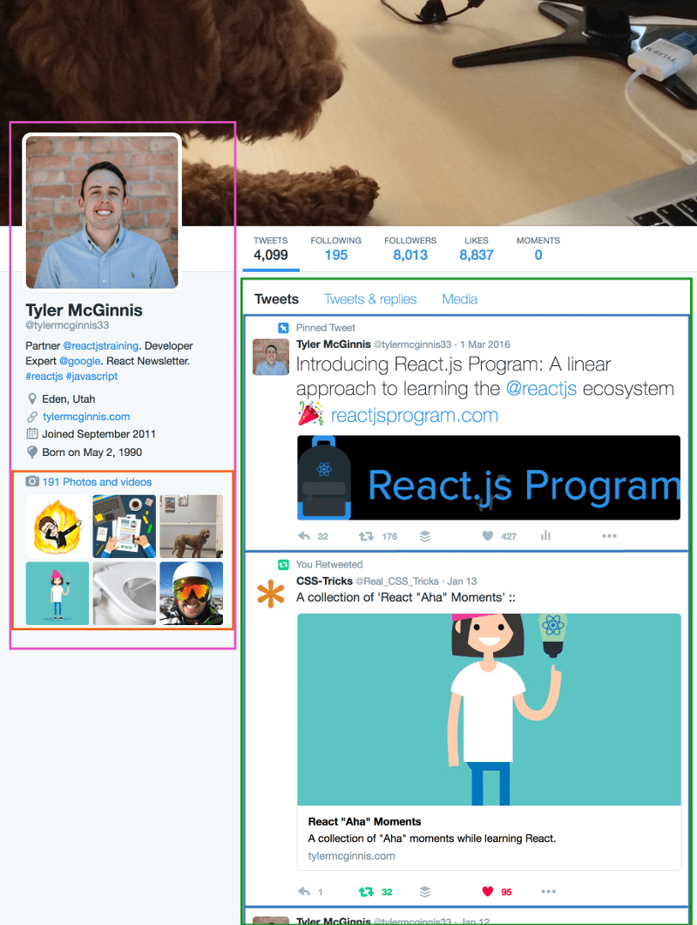
Componentization
Think of a component as a collection of HTML, CSS, JS, and some internal data specific to that component.
What makes React so convenient for building user interfaces is that data is either received from a component’s parent component, or it’s contained in the component itself.
We might take example of twitter user’s profile section, and name it “UserInfo” component. Inside the UserInfo component we have another component, that we could call the “UserImages” component, here we will have the photos of user. The way this parent/child relationship works is our UserInfo component, or the parent component, is where the ‘state’ of the data for both itself and the UserImage component (child component) lives. If we wanted to use any part of the parent component’s data in the child component, which we do, we would pass that data to the child component as an attribute. In this example, we pass the UserImage component all of the images that the user has (which currently live in the UserInfo component).
Notes:
Components are the building blocks of React.
Above we have a picture of my Twitter profile. If we were going to re-create this page in React, we would break different sections up into different components (highlighted). Notice that components can have nested components inside of them. We might name the left component (pink) the “UserInfo” component. Inside the UserInfo component we have another component (orange), that we could call the “UserImages” component. The way this parent/child relationship works is our UserInfo component, or the parent component, is where the ‘state’ of the data for both itself and the UserImage component (child component) lives. If we wanted to u component se any part of the parent component’s data in the child component, which we do, we would pass that data to the child component as an attribute. In this example, we pass the UserImage all of the images that the user has (which currently live in the UserInfo component). We’ll get more into the details of the code in a bit, but I want you to understand the bigger picture of what’s happening here. This parent/child hierarchy makes managing our data relatively simple because we know exactly where our data lives and we shouldn’t manipulate that data anywhere else.

Slide 11
var React = require("react");
var ReactDOM = require("react-dom");
require("./index.css");
class Helloworld extends React.Component {
render: function() {
return (
<div>
Hello World!
</div>
)
}
}
ReactDOM.render(
< Helloworld />,
document.getElementById('app'));
Every component is required to have a render method.
Helloworld is our component which will be rendered on the DOM
ReactDOM.render method renders the component on DOM. Uses the component name and DOM node id as arguments
The “HTML” that in the render method isn’t actually HTML but it’s what React is calling “JSX”.
React takes these JS objects and form a “virtual DOM”
render: function() {
return React.createElement("div", null, "Hello World");
}
Notes:
In the example above we’re telling React to take our Helloworld component and render it to the element with an ID of app. Because of the parent/child child relations of React we talked about earlier, you usually only have to use ReactDOM.render once in your application because by rendering the most parent component, all child components will be rendered as well.

Slide 12
DOM vs Virtual DOM

Slide 13

DOM (Document Object Model)
The WHAT Part
Document Object Model is a cross-platform and language-independent application programming interface that treats an HTML, XHTML, or XML document as a tree structure wherein each node is an object representing a part of the document
DOM is an abstraction of a structured text. If the structured text is an HTML code, then the DOM will be simply called HTML DOM. Elements of that HTML become nodes in the DOM.
Notes:
DOM : Api that creates a Tree structure out of HTML or other structured text.

Slide 14
DOM Processing
DOM
The HOW Part
HTML
HTML
PARSER
DOM
TREE
LAYOUT
While HTML is a text, the DOM is an in-memory representation of this text. The HTML DOM provides an interface (API) to traverse and modify the nodes. So, whenever we want to dynamicly change the content of the web page, we modify the DOM.
ATTACHMENT
RENDER
TREE
PAINTING
DISPLAY
The CSSOM and DOM trees are combined into a render tree, which is then used to compute the layout of each visible element and serves as an input to the paint process that renders the pixels to screen.
STYLE SHEETS
CSS
PARSER
CSSOM
TREE
Notes:
The DOM and CSSOM trees are combined to form the render tree.
Render tree contains only the nodes required to render the page.
Layout computes the exact position and size of each object. The output of the layout process is a "box model," which precisely captures the exact position and size of each element within the viewport: all of the relative measurements are converted to absolute pixels on the screen.
The last step is paint, which takes in the final render tree. Now that we know which nodes are visible, and their computed styles and geometry, we can pass this information to the final stage, which converts each node in the render tree to actual pixels on the screen.

Slide 15
NO!
Who Told You That?
Is the DOM really
SLOW?
People often throw around the statement “The DOM is slow”. This isn’t exactly true. The DOM is fast. Adding and removing DOM nodes doesn’t take much more than setting a property on a JavaScript object. It’s a simple operation.
Let’s test it out.
Ten THOUSAND divs in about 200 milliseconds.
What is slow with DOM, however, is the layout that browsers have to do whenever the DOM changes. Every time the DOM changes, browser need to recalculate the CSS, do layout, and repaint the web page. This is what takes time.
Notes:
The time required to perform render tree construction, layout and paint varies based on the size of the document, the applied styles, and the device it is running on: the larger the document, the more work the browser has; the more complicated the styles, the more time taken for painting also (for example, a solid color is "cheap" to paint, while a drop shadow is "expensive" to compute and render).

Slide 16

Problem as of now
SPAs
Since we are pushed towards dynamic web apps (Single Page Applications – SPAs), we need to modify the DOM tree incessantly and a lot.
This is a real performance and development pain. It comes with two major issues:
It’s hard to manage. Imagine that you have to tweak some functionality. If you lost the context, you have to dive really deep into the code to even know what’s going on. Both time-consuming and bug-risky.
It’s inefficient. Do we really need to do all this findings manually? Maybe we can be smarter and tell in advance which nodes are to-be-updated?
Notes:
Major concern -> Managing the SPAs

Slide 17
Solution be like React JS
1
2
HARD TO MANAGE
NOT EFFICIENT
Declarative-ness
Virtual DOM
Instead of low-level techniques like traversing the DOM tree manually, you simple declare how a component should look like. React does the low-level job for you – the HTML DOM API methods are called under the hood.
First of all – the Virtual DOM was not invented by React, but React uses it and provides it for free.
Virtual DOM solutions are built on top of standard DOM. They still utilize DOM eventually, but do it as little as possible and very efficiently.
Notes:
React implements a browser-independent DOM system for performance and cross-browser compatibility. It cleans up a few rough edges in browser DOM implementations.

Slide 18


The Blueprint
Virtual DOM
Virtual DOM is in-memory representation of Real DOM. It is lightweight JavaScript object which is copy of Real DOM.
The Virtual DOM is an abstraction of the HTML DOM. It is lightweight and detached from the browser-specific implementation details. Since the DOM itself was already an abstraction, the virtual DOM is, in fact, an abstraction of an abstraction.
Notes:
The Virtual DOM was not invented by React, but React uses it and provides it for free.
A copy/blueprint of DOM
VDOM: Abstraction of Abstraction
VDOM: lightweight and browser independent

Slide 19
What Makes VDOM Faster?
Efficient
Efficient
diff
Change Detection is done using
Batched
Update of
Sub-tree
Observables
Algorithm
Update
Operations
Instead of
Dirty
Checking
Notes:
Observable -> state

Slide 20
Diff Algorithm : The requirement
At a single point in time you can think of the render() function as creating a tree of React elements.
On the next state or props update, that render() function will return a different tree of React elements.
React then needs to figure out how to efficiently update the UI to match the most recent tree.
Notes:
-> Required to compare two different trees created due to modification

Slide 21

Diff Algorithm - Complexity
O(n)
Goal is to generate the minimum number of operations to transform one tree into another.
State of art algorithms have a complexity in the order of O(n3) where n is the number of elements in the tree
.
If we used this in React, displaying 1000 elements would require in the order of one billion comparisons.
This is far too expensive. Instead, React implements a Heuristic O(n) algorithm based on two assumptions:
Two elements of different types will produce different trees
The developer can hint at which child elements may be stable across different renders with a key prop
Notes:
Complexity level -> O(n)
A heuristic algorithm is one that is designed to solve a problem in a faster and more efficient fashion than traditional methods by sacrificing optimality, accuracy, precision, or completeness for speed. Heuristic algorithms are most often employed when approximate solutions are sufficient and exact solutions are necessarily computationally expensive.

Slide 22

Diff Algorithm - Assumptions
Assumption 1
<div><Counter /></div>
<span><Counter /></span>
Two elements of different types will produce different trees.
<div className="before" title="stuff" />
<div className="after" title="stuff" />
When diffing two trees, React first compares the two root elements. The behaviour is different depending on the types of the root elements.
Whenever the root elements have different types, React will tear down the old tree and build the new tree from scratch.
When comparing two React DOM elements of the same type, React looks at the attributes of both, keeps the same underlying DOM node, and only updates the changed attributes.
<div style={{color: 'red', fontWeight: 'bold'}} />
<div style={{color: 'green', fontWeight: 'bold'}} />
Notes:
Going from <a> to <img>, or from <Article> to <Comment>, or from <Button> to <div> - any of those will lead to a full rebuild.

Slide 23
Diff Algorithm - Assumptions
<ul>
<li>first</li>
<li>second</li>
</ul>
<ul>
<li>first</li>
<li>second</li>
<li>third</li>
</ul>
1
Assumption 2
The developer can hint at which child elements may be stable across different renders with a key prop.
<ul>
<li>Duke</li>
<li>Villanova</li>
</ul>
<ul>
<li>Connecticut</li>
<li>Duke</li>
<li>Villanova</li>
</ul>
<ul>
<li key="2015">Duke</li>
<li key="2016">Villanova</li>
</ul>
<ul>
<li key="2014">Connecticut</li>
<li key="2015">Duke</li>
<li key="2016">Villanova</li>
</ul>
By default, when recursing on the children of a DOM node, React just iterates over both lists of children at the same time and generates a mutation whenever there’s a difference. [Snippet 1]
If you implement it naively, inserting an element at the beginning has worse performance. [Snippet 2]
In order to solve this issue, React supports a key attribute. When children have keys, React uses the key to match children in the original tree with children in the subsequent tree. [Snippet 3]
2
3
Notes:
For example, when adding an element at the end of the children, converting between these two trees works well: React will match the two <li>first</li> trees, match the two <li>second</li> trees, and then insert the <li>third</li> tree.
If you implement it naively, inserting an element at the beginning has worse performance. For example, converting between these two trees works poorly. React will mutate every child instead of realizing it can keep the <li>Duke</li> and <li>Villanova</li> subtrees intact.
After implementing the key, React knows that the element with key '2014' is the new one, and the elements with the keys '2015' and '2016' have just moved.

Slide 24
Diff Algorithm – Traversing VDOM
A
Breadth First Search
B
C
ReactJS traverses the tree using Breadth First Search algorithm
D
E
F
G
States of element B and H have changed. So when using BFS, ReactJS reached element B it will by default re-render the element H. This is the reason to use BFS for tree traversal.
H
I
Notes:
For example, when adding an element at the end of the children, converting between these two trees works well: React will match the two <li>first</li> trees, match the two <li>second</li> trees, and then insert the <li>third</li> tree.
If you implement it naively, inserting an element at the beginning has worse performance. For example, converting between these two trees works poorly. React will mutate every child instead of realizing it can keep the <li>Duke</li> and <li>Villanova</li> subtrees intact.
After implementing the key, React knows that the element with key '2014' is the new one, and the elements with the keys '2015' and '2016' have just moved.

Slide 25
Batch Update
ReactJS using the diff algorithm to find the minimum number of steps to update the Real DOM.
Once it has these steps, it executes all the steps in one event loop without involving the steps to repaint the Real DOM. Thus, if there are more element which gets updated ReactJS will wait for the event loop to finish then, in bulk will updated the real DOM with all the updated elements.
Once all the steps are executed, React will repaint the Real DOM. This means during the event loop, there is exactly one time when the Real DOM is being painted. Thus all the layout process will run only on time for updating the real DOM.
Notes:
In more layman’s terms, React is able to minimize manipulations to the actual DOM by keeping track of a virtual DOM and only updating the real DOM when necessary and with only the necessary changes.

Slide 26

Quick view on Virtual DOM Process
Detect Changes
Using observables, signal to notify our app some data has changed
1
2
Re-render Virtual DOM
Whenever setState() method is called on any component, ReactJS makes that component dirty and re-renders it
React App
Apply Diff Algorithm
Compare previous virtual DOM with new virtual DOM to evaluate the changes
3
4
Update Real DOM
Only update real DOM with necessary changes evaluated by diff algorithm
Notes:
Virtual DOM Process looks like this.

Slide 27
That’s it Folks

